Slide 1
OpenCart (TutorialNinja) Automation Project
By Danish Jamadar
Under Guidance of Mrs. Vaishali Sonawane Mam.

Slide 2
Introduction
Why automation testing is needed for eCommerce websites?
eCommerce sites have frequent updates with new products, offers, and features.
Manual testing is time-consuming and error-prone.
Automation ensures:
Accuracy & consistency in repeated test cases.
Faster execution of regression and functional testing.
Scalability to handle multiple scenarios across browsers.
Early defect detection, improving product quality and customer experience.

Slide 3
Modules
Registration
Authentication (Login)
Search
Cart (Add/Delete)
Currency selection
Adding Address
Navigation (Hover Menus)
Checkout

Slide 4
Responsibilities
Create Test Plan
Create test cases
Writing & Automating Test Cases (Selenium + Cucumber)
Create test analysis report
Find defects and create Defect Report

Slide 5
Overview
What is OpenCart (TutorialNinja demo site)?
OpenCart is an open-source eCommerce platform used to build online stores.
The TutorialNinja demo site is a sample implementation of OpenCart, where users can explore features such as:
Product browsing and search
User authentication (login/register)
Shopping cart and checkout
Product details and reviews
Wishlist and product comparison

Slide 6
Modules Description
Module 1:Registration
Checked Registration functionalities in registration tab with proper user credentials
Module 2 : Authentication (Login/Logout)
Checked all the functionalities on Sign in page which included personal info as email address, password.
Module 3 : Product Search
Verified the product search functionality including search bar, auto-suggestions, and search results display.

Slide 7
Module 4 : Cart (Add/Delete)
Checking add to cart, remove from cart and view cart summary functionalities whether it updating or not correctly
Module 5 : Currency selection
Checking functionalities of "Currency selection " for displaying product price for shopping
Module 6 :Add Address
Checking functionality to address of customer with proper credentials
Module 7 : Navigation (Hover Menus)
Checking different types of category by scrolling mouse
Module 8 : Checkout Process
Checking Checkout functionality

Slide 8
DEFECTS
Search returns empty results for certain valid items.

Slide 9
Defect identifier :- B_001
Ø Defect summary :- While a particular product is searched it should be displayed or relevant products should e displayed but it dislays "There is no product that matches the search criteria."
Ø Test Id :- TC_1
Ø Test case name :- TC_Search
Ø Module name :- Search
Ø Reproducible :- Displayrele Products when product searched
Ø Severity :- Medium
Ø Priority :- Medium
Ø Raised by :- Danish Jamadar
Ø Assigned to :-
Ø Date of assignment :- 9/9/2025
Ø Status :- OPEN
Ø Snap shots :-
Ø Fixed by :- developer
Ø Date of fixing :-

Slide 10
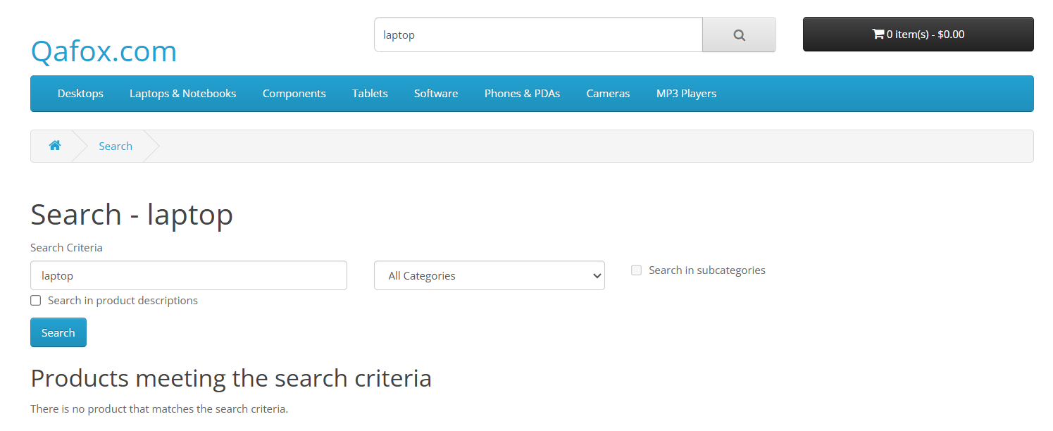

Slide 11
CHALLENGES
Challenges Faced :
Synchronization issues between Cucumber steps and page loads
Handling dynamic locators in TutorialNinja site
Managing multiple feature files & reusing steps

Slide 12
Experience
Hands-on with Cucumber BDD framework
Improved skills in writing Gherkin scenarios
Enhanced understanding of POM + Cucumber integration + Jenkins
Reporting defects and documenting using structured format

Slide 13

THANK YOU!!!!

